Slide 1
Unit II: INTRODUCTION TO TABLEAU

Slide 2
Table of contents
Introduction and Installing Tableau
Tableau features
Connecting data with tableau
Joining data sources
Live data connections vs data extracts
Basic functions of tableau
Operations of tableau
Usage of Menus and Toolbar
Usage of Data Pane, Analytics Pane, Sheet Tabs, Shelves and Cards, Marks Card, Legends.
Layout for dashboard and stories
Difference between Green and Blue pills

Slide 3
1. Introduction and Installing Tableau
Tableau is a business intelligence tool with interactive data visualization features
User friendly and easy to learn
A business intelligence tool
An interactive data visualization software

Slide 4
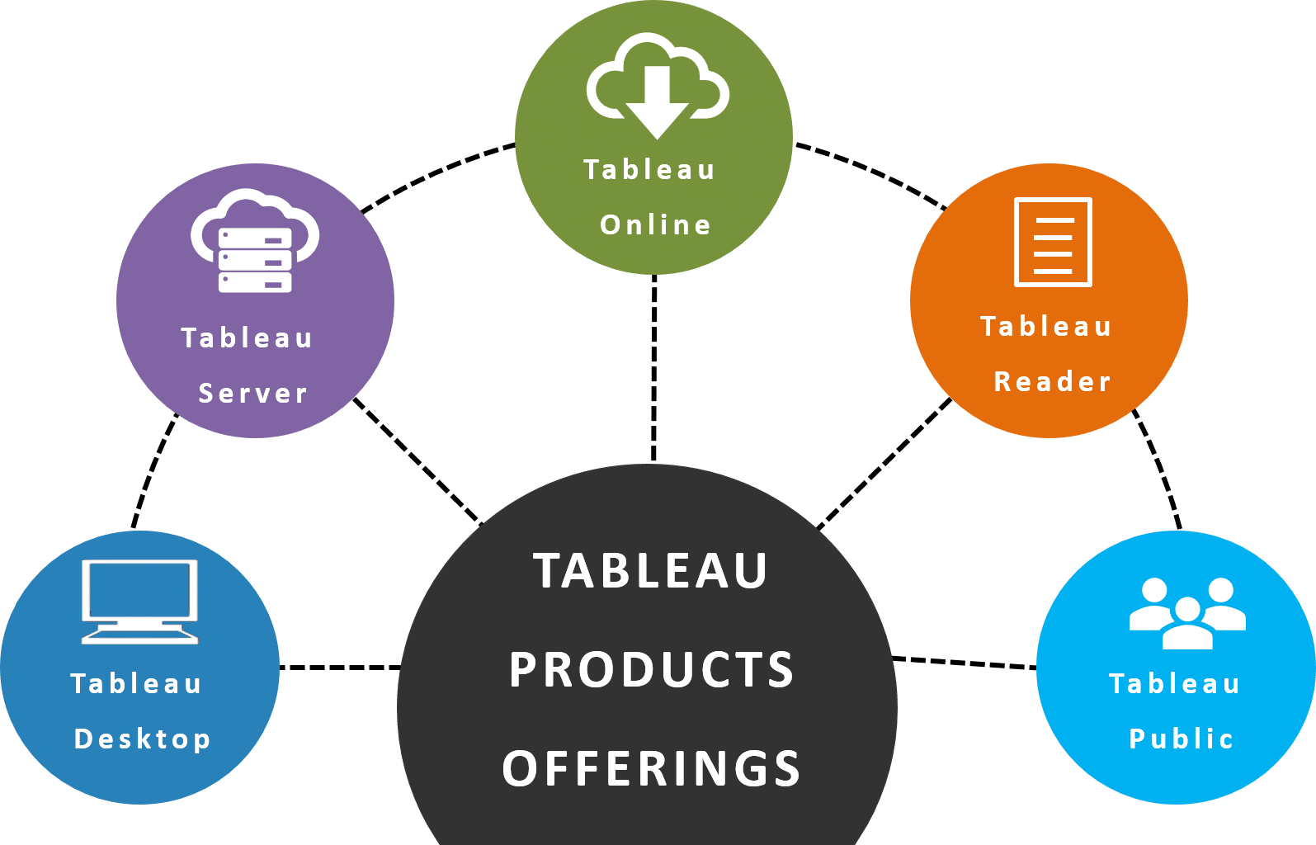
Notes:
https://intellipaat.com/blog/tutorial/tableau-tutorial/introduction-tableau/

Slide 5
Different Tableau Products
Tableau Desktop is business analytics anyone can use, even when you are offline.
Tableau Server is a web product of Tableau that allows users to do collaborative work on the same database at two different places
Tableau Online Tableau Online is a cloud-based platform that performs the same functionality as Tableau Server.
Tableau Public is a free product of Tableau which provides some limited functionalities for those who want to learn data visualization.

Slide 6
2. Tableau features
Informative Dashboards
Supports numerous data sources
Connectivity with Live and In-Memory Data
Provides Great Security
Easy Collaboration & Sharing
Provides a Mobile Version
Advanced Visualization Capabilities
Availability of Maps
Trend Lines & Predictive Analysis
Notes:
https://www.fusionspan.com/blog/10-important-features-of-tableau/

Slide 7
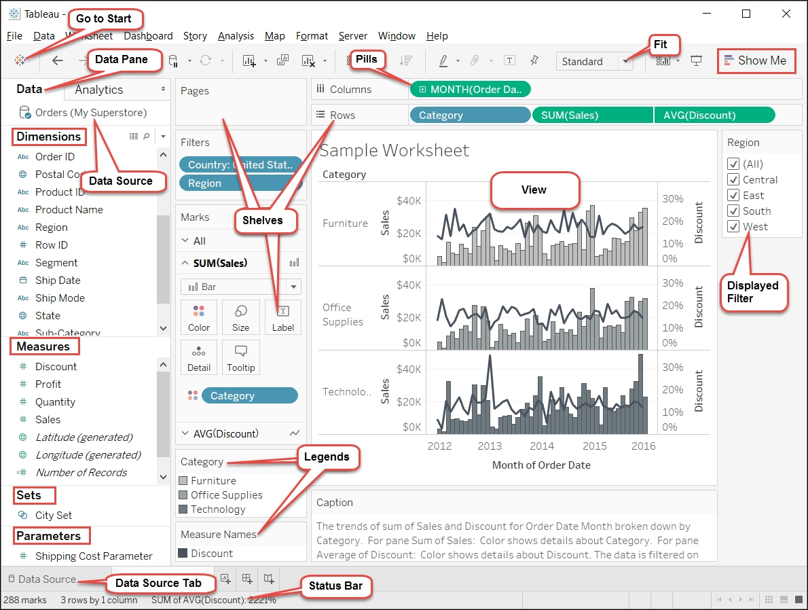
Tableau interface

Slide 8
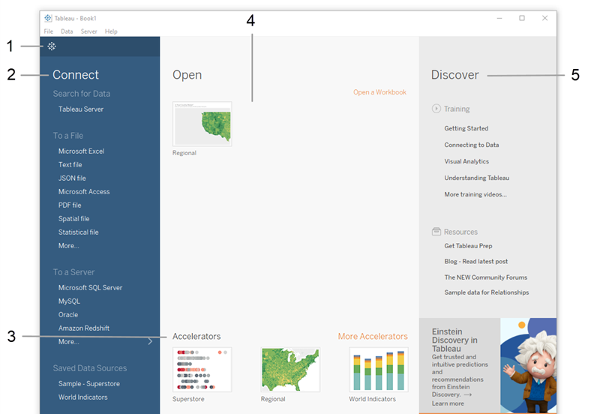
Tableau icon
Connect pane
Accelerators: sample workbooks that come with Tableau Desktop

Slide 9
Contd…
1. Tableau icon. Click in the upper left corner of any page to toggle between the start page and the authoring workspace.
2. Connect pane. Under Connect, you can:
Connect to data that is stored in a file, such as Microsoft Excel, PDF, Spatial files, and more.
Connect to data that is stored on Tableau Server, Microsoft SQL Server, Google Analytics, or another server.
3. Under Accelerators, see a selection of Accelerators and the sample workbooks that come with Tableau Desktop. Prior to 2023.2, these were only sample workbooks.
4. Under Open, you can open workbooks that you've already created.
5. Under Discover, find additional resources like video tutorials, forums, or the “Viz of the week” to get ideas about what you can build.
Notes:
https://help.tableau.com/current/guides/get-started-tutorial/en-us/get-started-tutorial-drag.htm

Slide 10
Contd…
In the Connect pane, under Saved Data Sources, click Sample - Superstore to connect to the sample data set.

Slide 11
3. Connecting data with tableau
Just drag and drop the file on tableau
OR
Follow the steps below:

Slide 12
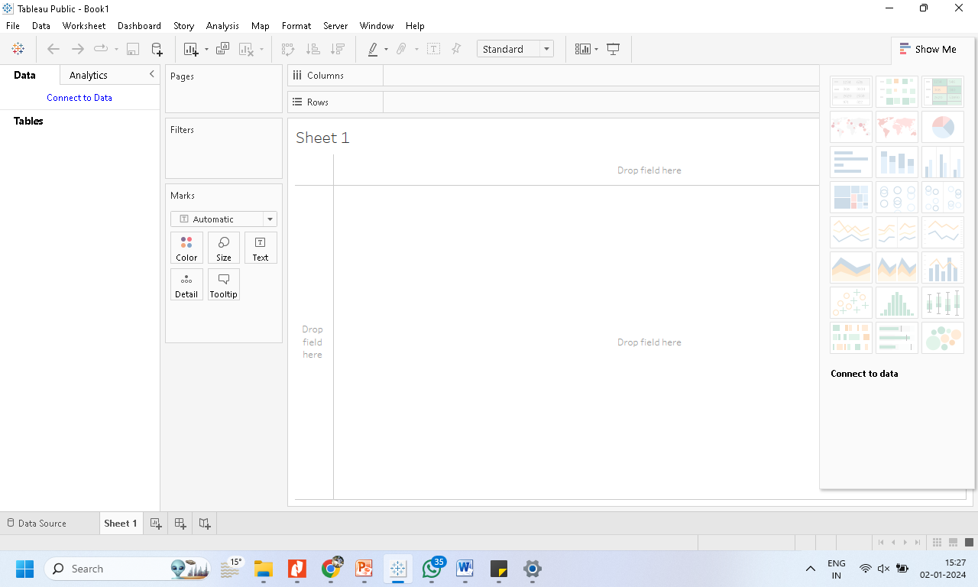
Click tableau icon

Slide 13
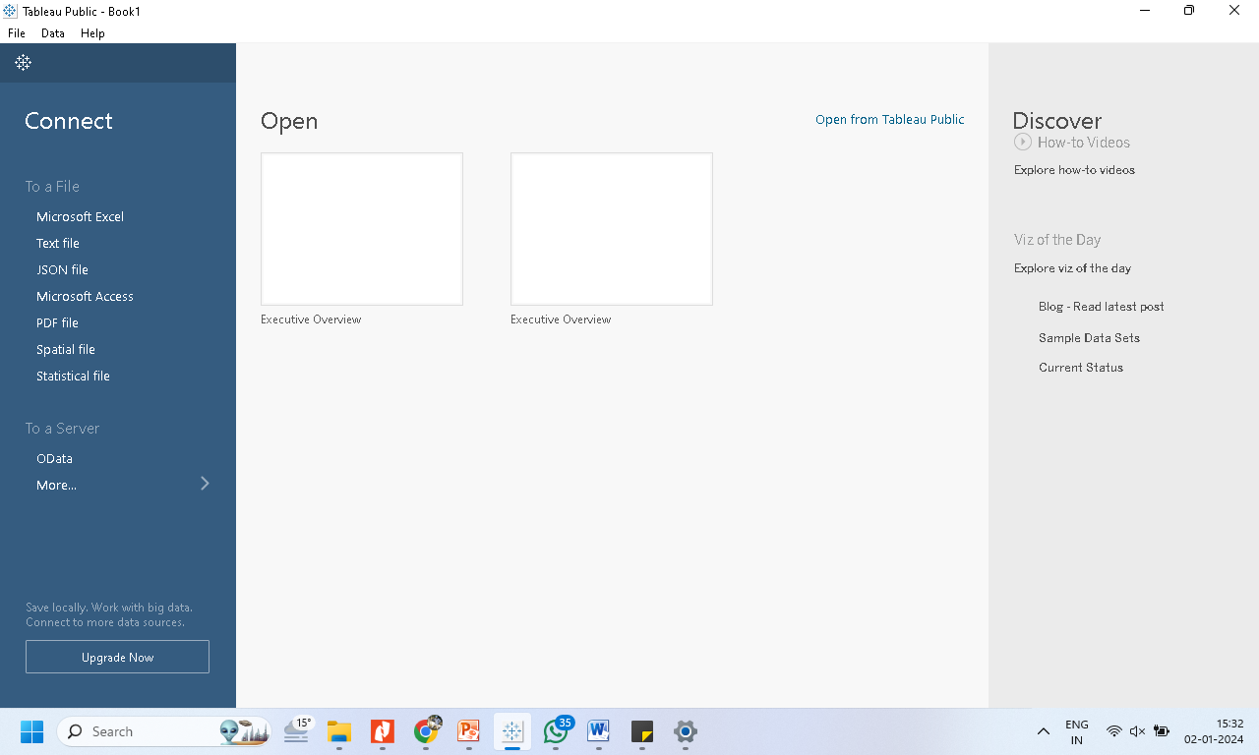
Select the option to connect to data source

Slide 14
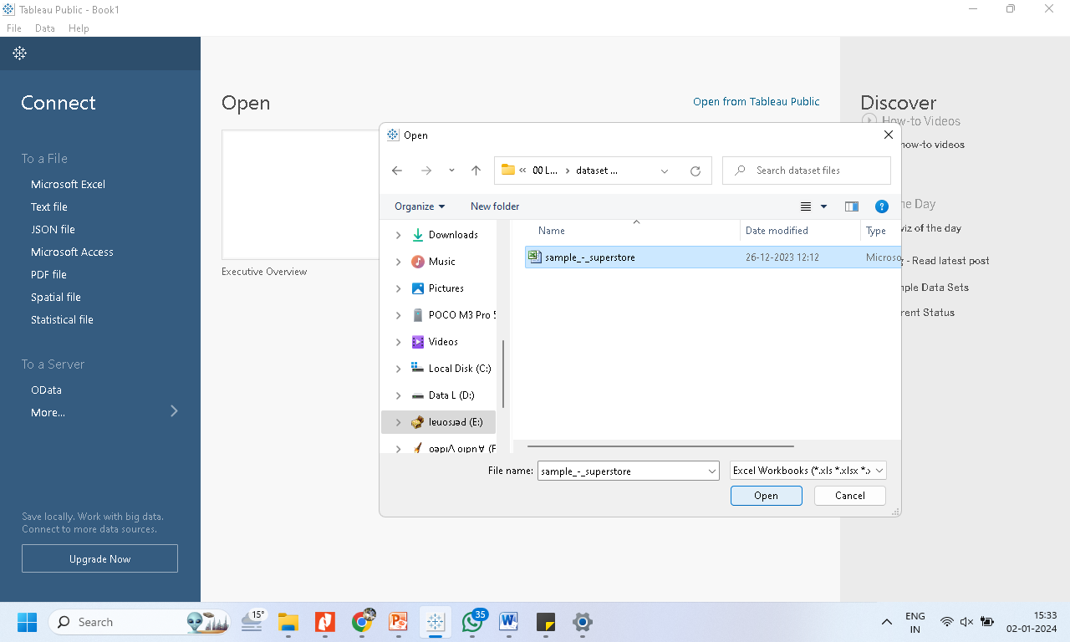
Select a file

Slide 15
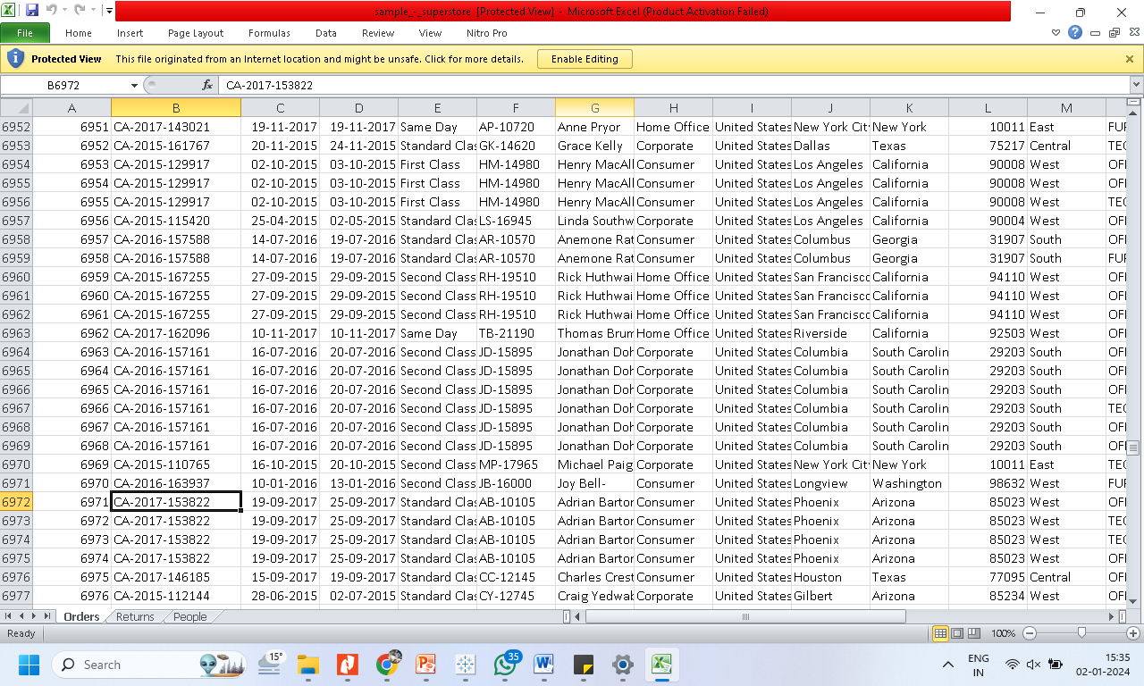
In this case this excel file is consider

Slide 16
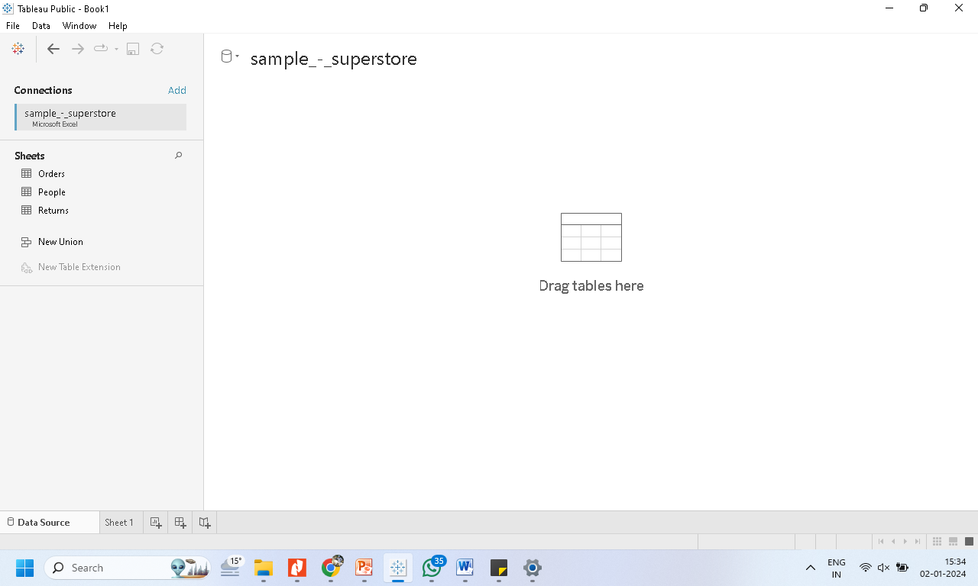
Data imported to tableau

Slide 17
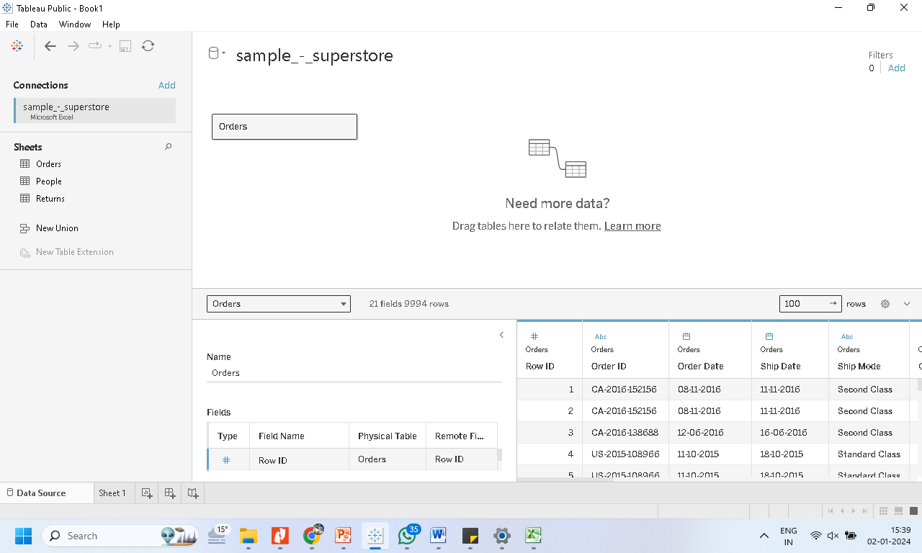
Drag the table on to the canvas

Slide 18
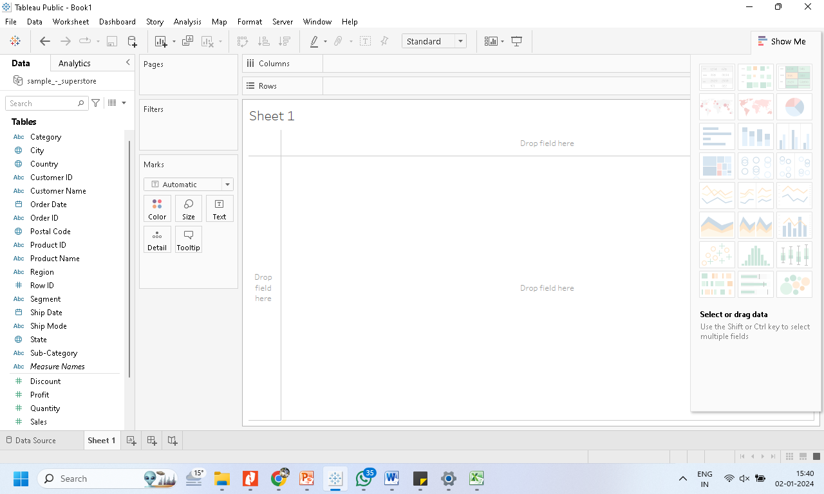
Now click on the Sheet

Slide 19
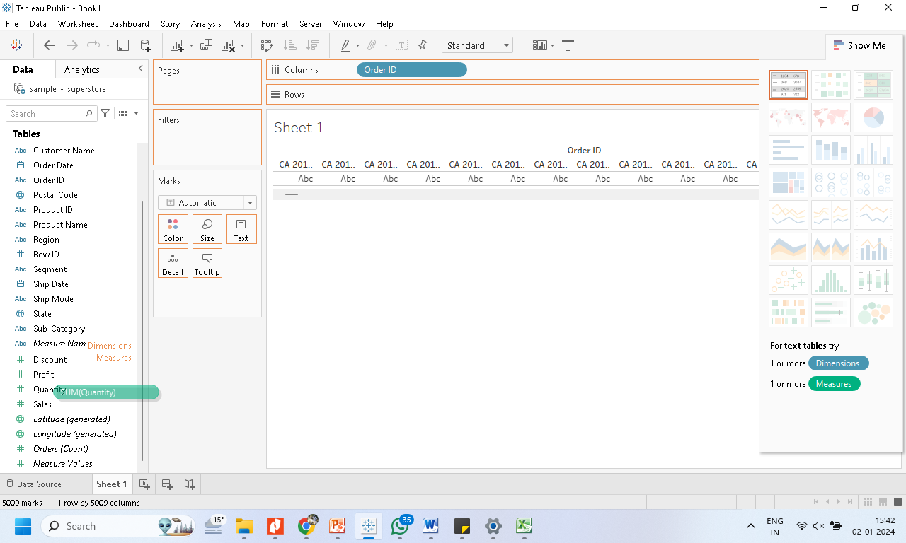
Drag fields to the rows and column from the pane

Slide 20
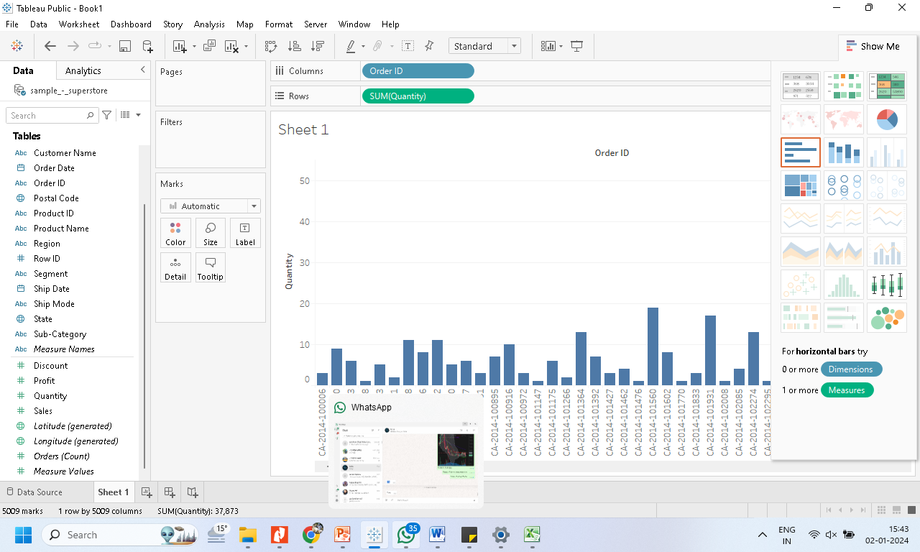
The chart will be created on the view

Slide 21
4. Joining data sources
It is often necessary to combine data from multiple places—different tables or even data sources—to perform a desired analysis. Depending on the structure of the data and the needs of the analysis, there are several ways to combine the tables.
Relationships and
Joins

Slide 22
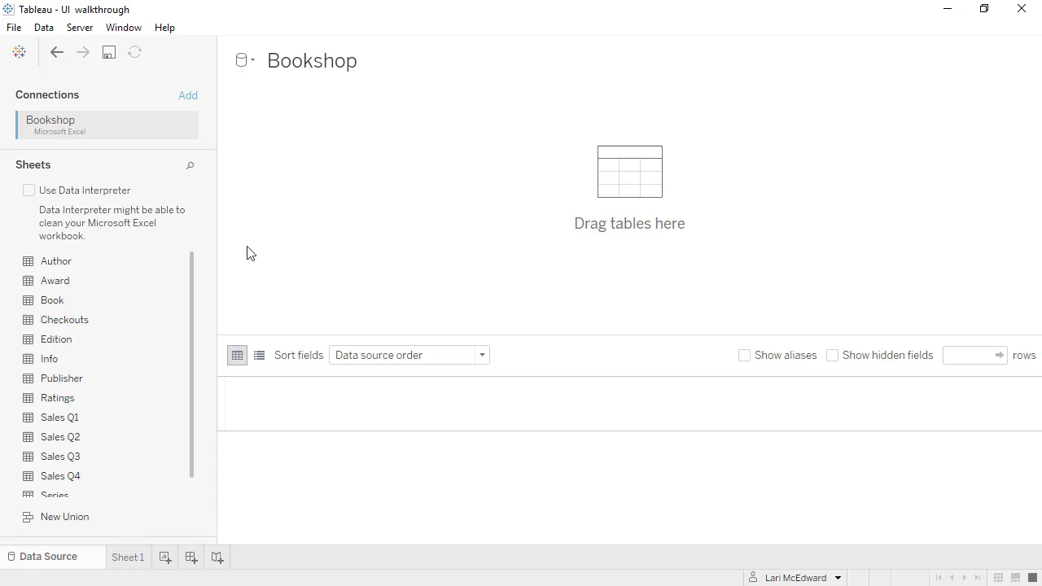
Relationships and join

Slide 23
Joins
Join is in the 'physical layer' of Tableau's data model.
Unlike a relationship, a join will combine two tables into one.
It is represented by a Venn diagram.
We might want to control the way that we combine the tables, or deliberately filter or duplicate certain fields.
Limitations of joins: - Joins may sometimes produce missing or unmatched data fields. - Joins cannot be used on published data sources. - The fields being joined must be of the same data type. If the data type is changed after the join, the join will break. - If we want to delete a field involved in the join (i.e. a duplicated field), we can’t do so without breaking the join.
Notes:
https://www.thedataschool.co.uk/penny-richmond/tableau-desktop-relationships-vs-joins/

Slide 24
Relationships
Relationships are a dynamic, flexible way to combine data from multiple tables for analysis.
A relationship describes how two tables relate to each other, based on common fields, but doesn’t merge the tables together.
Use relationships as your first approach to combining your data because it makes data preparation and analysis easier and more intuitive.
Notes:
https://help.tableau.com/current/online/en-us/datasource_relationships_learnmorepage.htm

Slide 25
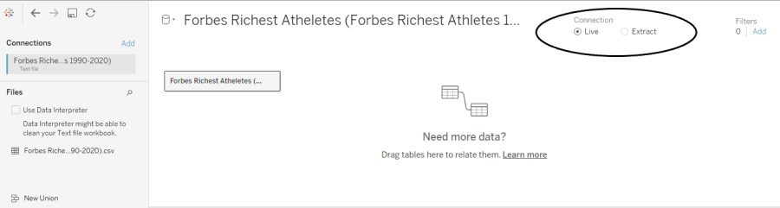
5. Live vs extract

Slide 26
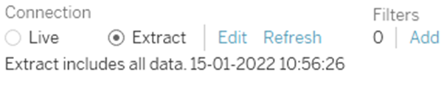
5.1 Steps Extracting Data in Tableau
Step1 → Chose “Extract” Connection
Step2 → When we chose “Extract” Data, Tableau ask for the location of .hyper file.
Step1 → Go to the Data pane and right-click on Data Connection and click on “Extract Data”
Step2 → Add filters and modify the extract according to your needs.

Slide 27
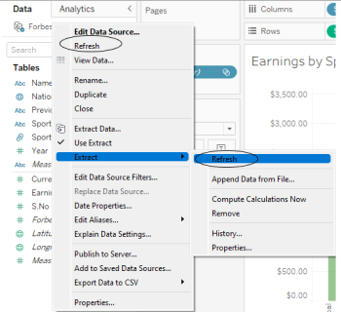
Refreshing an Extract in Tableau
The first option will refresh the connection, but since the connection is static, there won’t be any changes reflected in your data.
Notes:
https://towardsai.net/p/l/live-vs-extract-connection-a-road-to-tableau-desktop-specialist-certification

Slide 28
5.1 Data extracts
are snapshots of data optimized for loaded into system memory.
tend to be much faster than live connections.
doesn’t need the database to build the visualization.
Instead, Tableau’s in-memory data engine queries the extract directly.
the extract will need to be refreshed to receive updates from the original data source.
Use .hyper file

Slide 29
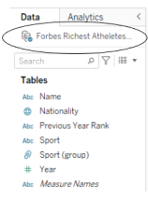
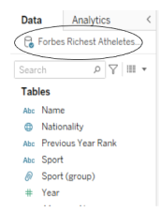
Difference
Double Cylinder represents Extract connection
Single Cylinder represents Live Connection

Slide 30
5.2 Live data connections
Live connections offer the convenience of real-time updates, with any changes in the data source reflected in Tableau.
But live connections also rely on the database for all queries.
And unlike extracts, databases are not always optimized for fast performance.
With live connections, your data queries are only as fast as the database itself.

Slide 31
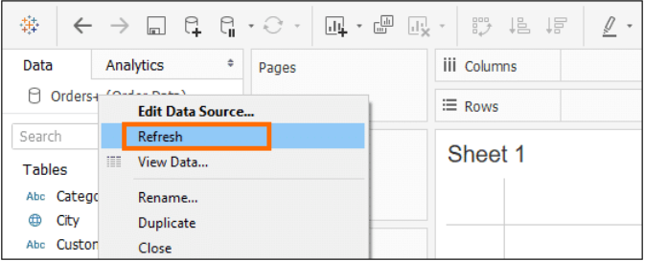
5.2 Live connection
when we want our data to keep flowing in our Tableau Data source from a dynamic database.
By default, the connection, it is a Live connection

Slide 32
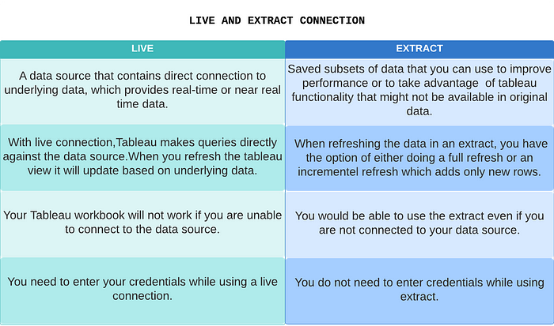
5. Live data connections vs data extracts

Slide 33
6. Basic functions of tableau
Number functions: Ceiling, Power, Round .
String functions: LEN, LTrim, UPPER
Date functions: DAY, NOW (),
Logical functions: ISDATE (string), IFNULL(e1,e2)
Aggregate functions: AVG , COUNT , MEDIAN .

Slide 34
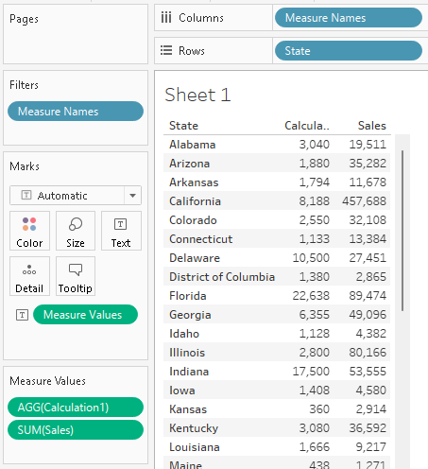
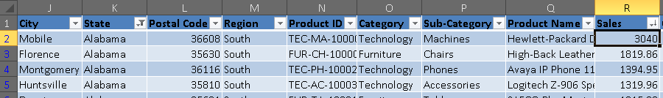

Slide 35
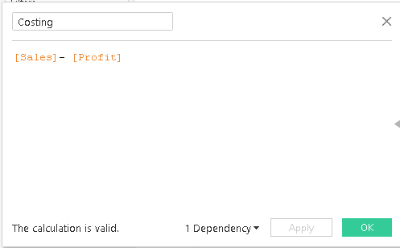
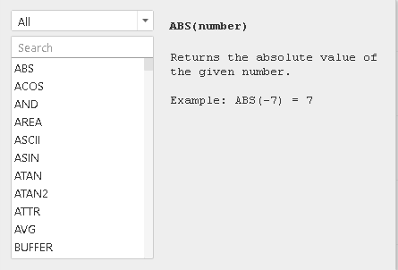
using the Calculated Field

Slide 36
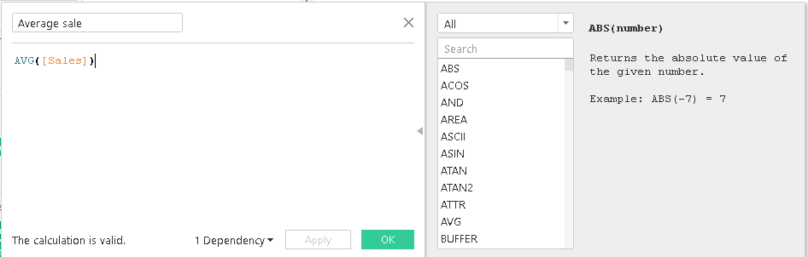

Slide 37
7. Operations of tableau
The order of operations in Tableau, sometimes called the query pipeline, is the order in which Tableau performs various actions.
Actions are also known as operations.
Many operations apply filters, which means that as you build a view and add filters, those filters always execute in the order established by the order of operations.
Notes:
https://help.tableau.com/current/pro/desktop/en-us/order_of_operations.htm

Slide 38
By default, all filters that you set in Tableau are computed independently.
Each filter accesses all rows in your data source without regard to other filters.
However, you can set one or more categorical filters as context filters for the view.
You can think of a context filter as being an independent filter.
Any other filters that you set are defined as dependent filters because they process only the data that passes through the context filter.

Slide 39
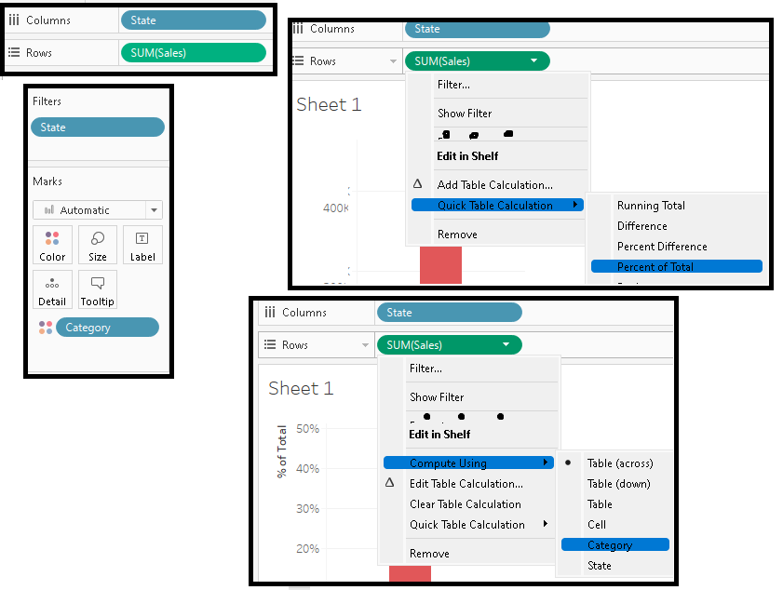
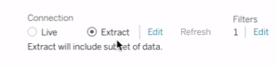
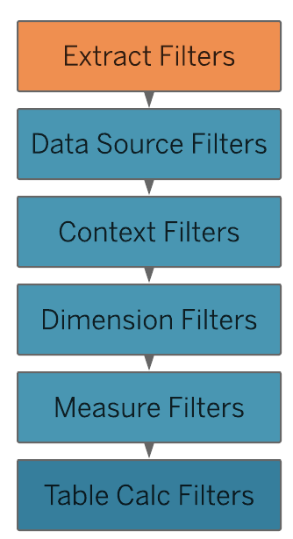
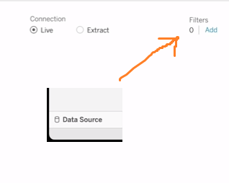
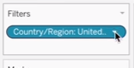
Sheet Specific

Slide 40
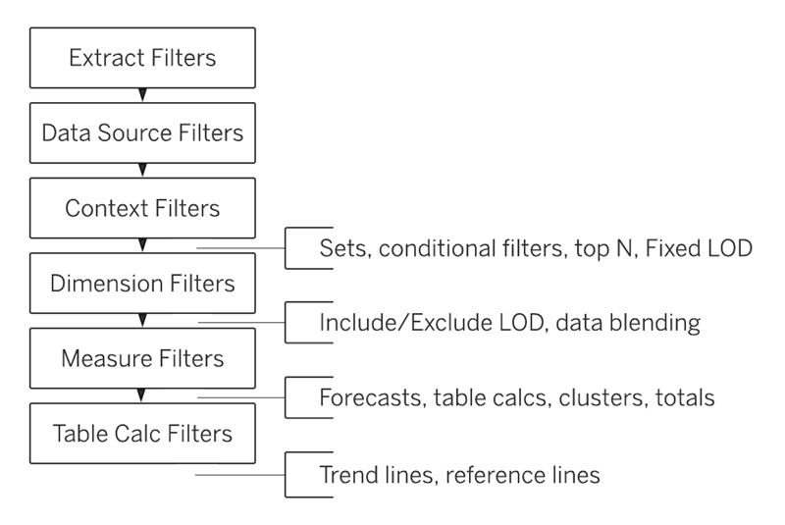
Read more: https://help.tableau.com/current/pro/desktop/en-us/order_of_operations.htm

Slide 41
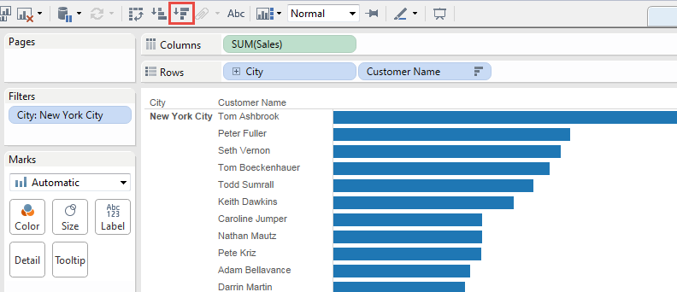
Who are the top 10 customers, by total sales, in New York City?
The above view is actually showing the top 10 customers overall.

Slide 42
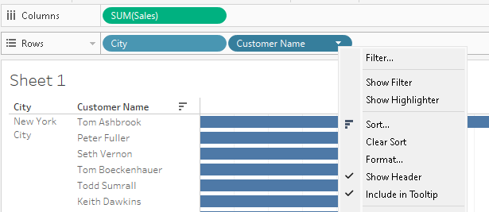
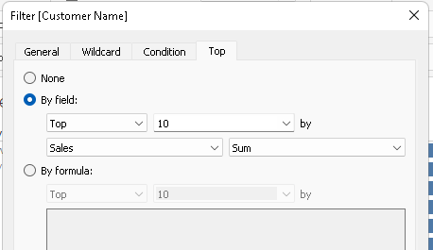

Slide 43
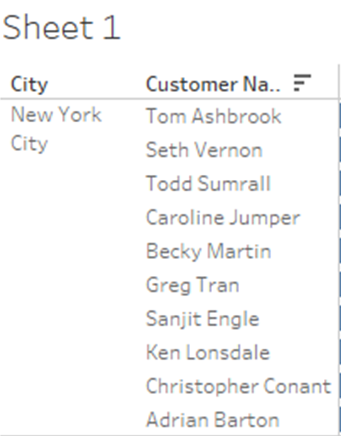
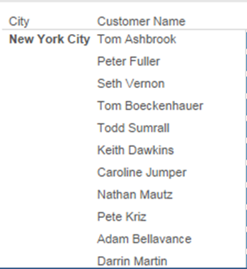
Incorrect output

Slide 44
incorrect output of scenario
The problem is that the dimension filters
top and
general
are applied simultaneously- they are both dimension filters,
and they appear in the same place in the Tableau order of operations (discussed in slide 39).

Slide 45
solution
The solution is to add the general dimension filter (on City) to context
that is, by turning it into a context filter, which is executed before any other filter that you create in a worksheet.
Right-click City on the Filters shelf and choose Add to Context.
As a context filter, this filter now takes precedence over the dimension filter

Slide 46
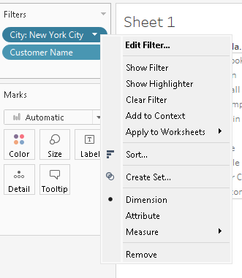

Slide 47
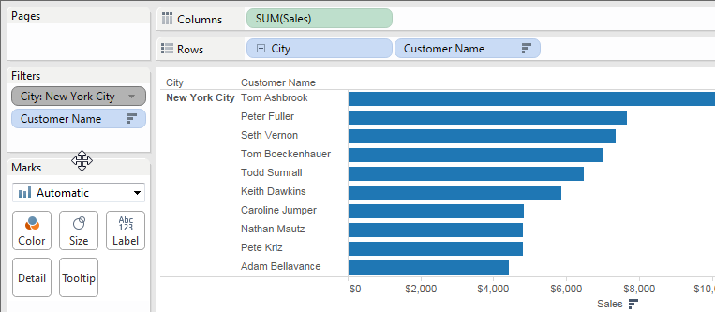
required output

Slide 48
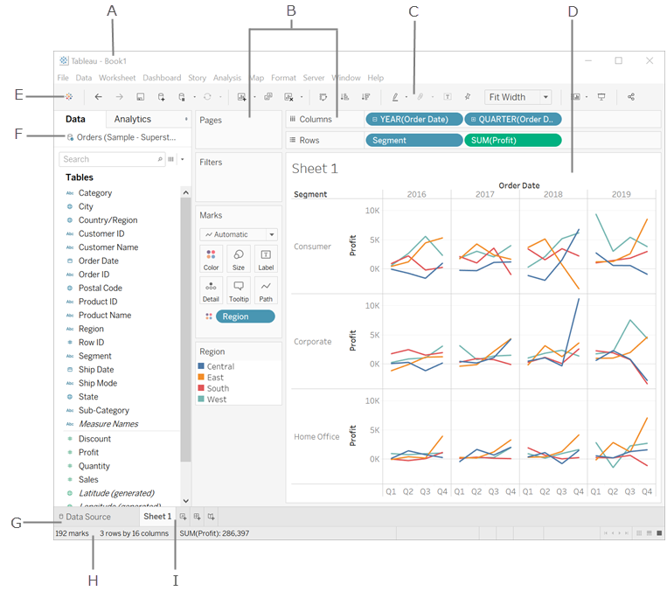
8. Usage of Menus and Toolbar
A. Workbook name. A workbook contains sheets. A sheet can be a worksheet, a dashboard, or a story.
B.Cards and shelves - Drag fields to the cards and shelves in the workspace to add data to your view.
C.Toolbar - Use the toolbar to access commands and analysis and navigation tools.
D.View - This is the canvas in the workspace where you create a visualization (also referred to as a "viz").
F.Side Bar - In a worksheet, the side bar area contains the Data pane and the Analytics pane.
G. Click this tab to go to the Data Source page and view your data. For more information,
H.Status bar - Displays information about the current view.
I. Sheet tabs - Tabs represent each sheet in your workbook. This can include worksheets, dashboards, and stories
Notes:
https://help.tableau.com/current/pro/desktop/en-us/environment_workspace.htm

Slide 49
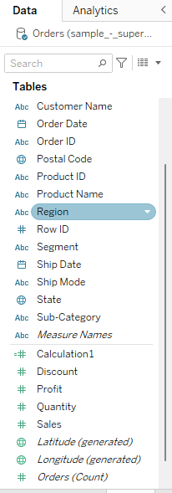
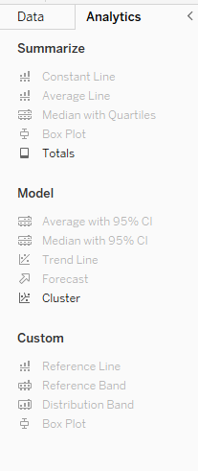
9.1 Usage of Data Pane, Analytics Pane
Tableau displays data source connections and data fields for the workbook in the Data pane on the left side of the workspace.
Drag reference lines, box plots, trend lines forecasts, and other items into your view from the Analytics pane, which appears on the left side of the workspace.
Notes:
https://help.tableau.com/current/pro/desktop/en-us/datafields_understanddatawindow.htm

Slide 50
9.2 Sheet Tabs
A workbook contains sheets. A sheet can be a worksheet, a dashboard, or a story.
A worksheet contains a single view along with shelves, cards, legends, and the Data and Analytics panes in its side bar.
A dashboard is a collection of views from multiple worksheets. The Dashboard and Layout panes are available in its side bar.
A story contains a sequence of worksheets or dashboards that work together to convey information. The Story and Layout panes are available in its side bar.

Slide 51
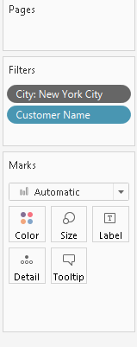
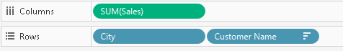
9.3 Shelves and Cards
By placing fields on shelves or cards, you:
Build the structure of your visualization.
Increase the level of detail and control the number of marks in the view by including or excluding data.
Add context to the visualization by encoding marks with color, size, shape, text, and detail

Slide 52
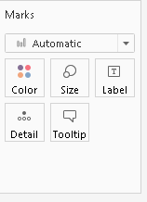
9.4 Marks card and Legends
The Marks card is a key element for visual analysis in Tableau.
As you drag fields to different properties in the Marks card, you add context and detail to the marks in the view.
Some shelves, legends, cards, or controls are only displayed as a result of things that you do as you work with views.
For example, the Color legend is only displayed when there is a field on Color.

Slide 53
10. Layout for dashboard and stories
A dashboard is a collection of several views, letting you compare a variety of data simultaneously.
Eg. if you have a set of views that you review every day, you can create a dashboard that displays all the views at once, rather than navigate to separate worksheets.
Data in sheets and dashboards is connected; when you modify a sheet, any dashboards containing it change, and vice versa.

Slide 54
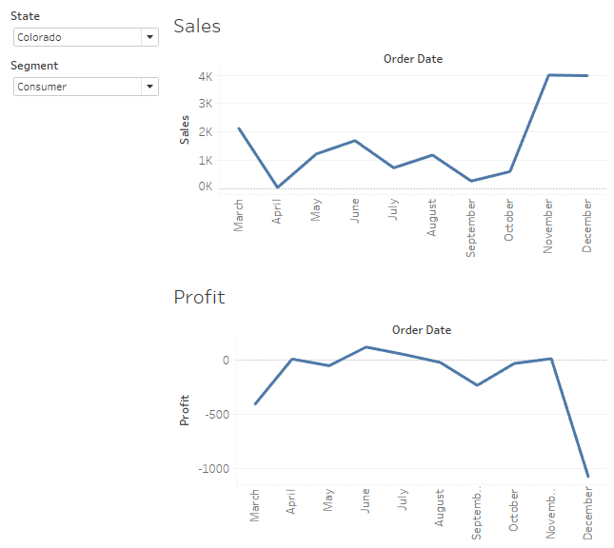
Dashboard

Slide 55
Stories
It is a sequence of visualizations that work together to convey information.
You can create stories to tell a data narrative, provide context, demonstrate how decisions relate to outcomes, or to simply make a compelling case.
Each individual sheet in a story is called a story point.

Slide 56
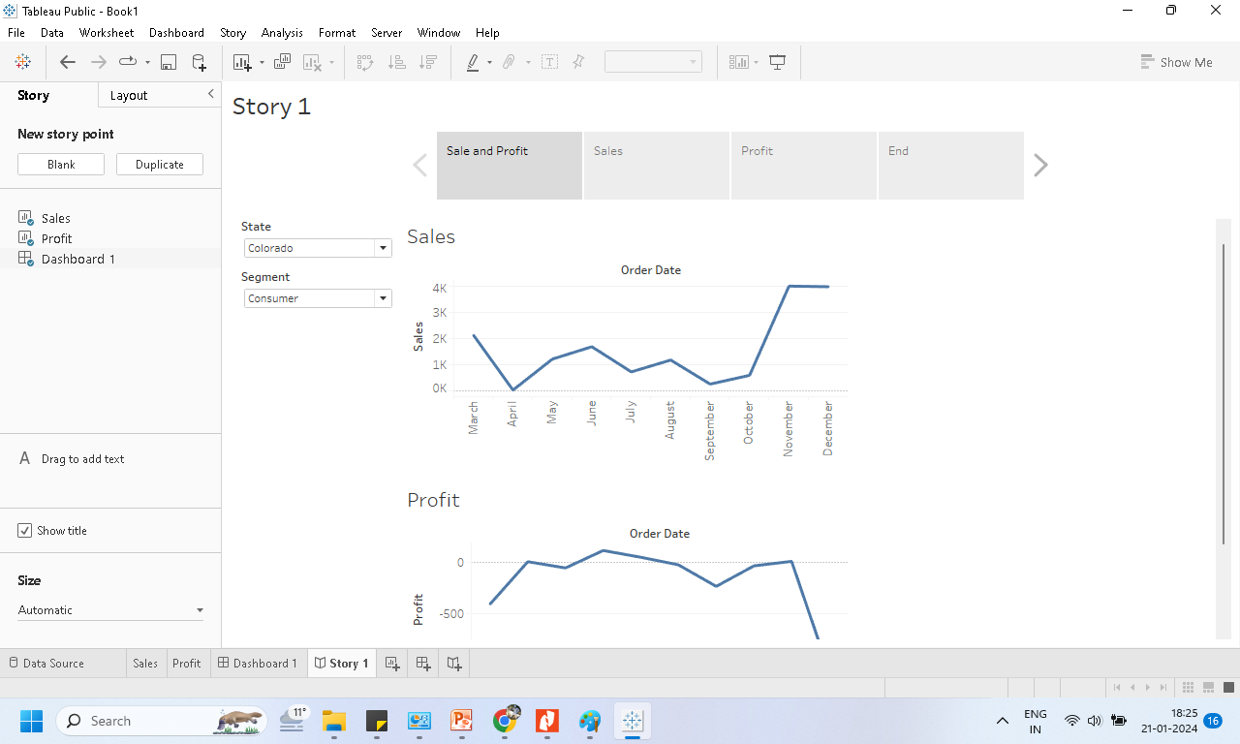

Slide 57
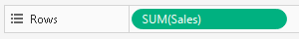
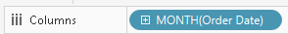
11. Difference between Green and Blue pills
Continuous means "forming an unbroken whole, without interruption".
These fields are colored green.
When a continuous field is put on the Rows or Columns shelf, an axis is created in the view.
Discrete means "individually separate and distinct.“
These fields are colored blue.
When a discrete field is put on the Rows or Columns shelf, a header is created in the view.

Slide 58


